Slide 1
Distance Vector Routing (DVR) in C++
IT303 Computer Networks
ADITYA SINGH 2K19/EP/005
ARKAJYOTI CHAKRABORTY 2K19/EP/022
Submitted By :

Slide 2
Background of Routing Algorithms
A routing algorithm is a procedure that lays down the route or path to transfer data packets from source to the destination. They help in directing Internet traffic efficiently. After a data packet leaves its source, it can choose among the many different paths to reach its destination.
Routing algorithm mathematically computes the best path, i.e. “least – cost path” that the packet can be routed through.
Exterior Gateway Protocols : Path Vector -> BGP
Interior Gateway Protocols : Distance Vector -> RIP, EIGRP
Link State -> IS-IS, OSPF
Notes:
Exterior - for routing across autonomous systems.
Interior - for routing within autonomous systems.

Slide 3
How to Decide Cost of Links
Bandwidth
Network Delay
Hop Count
Path Cost
Load
Maximum Transaction Unit

Slide 4
Goals of Routing Algorithms
Should correctly deliver.
Efficient utilization of bandwidth
Should not starve a node.
Should handle the changes well (fast convergence)
Router goes down,
Link goes down,
Lost changes,
New router added.

Slide 5
Distance Vector Routing (DVR)
A distance-vector routing (DVR) protocol requires that a router inform its neighbors of topology changes periodically. Historically known as the old ARPANET routing algorithm.
Based on Bellman-Ford Shortest Path Algorithm.
Does have count to infinity problem (very slow convergence in case of failures).
Comes under Network Layer according to OSI Model. Distance Vector routing uses UDP (User datagram protocol) for transportation.
Compared to Link State, requires less computations and message overhead.

Slide 6
Implementation
Each node maintains vector of distances and next hop for all destinations.
Nodes periodically send vectors to neighbors.
After receiving a distance vector, a node simply updates shortest distances (if needed).

Slide 7
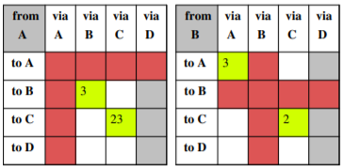
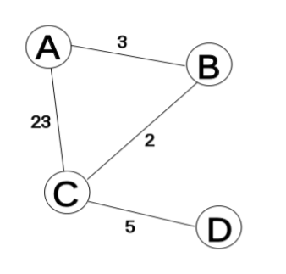
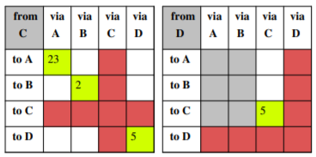

Slide 8
Calculation
d(x, y) = Estimate of least cost from x to y
Updated as : d(x, y) = min ( d(x, y) , d(x, z) + d(z, y) )
After every router has exchanged 1st (initial) distance vector and have updated distances, every router knows shortest distance with at most one immediate hop,
d(A, z) = min ( d(A, z) , d(A, C) + d(C, z) )

Slide 9
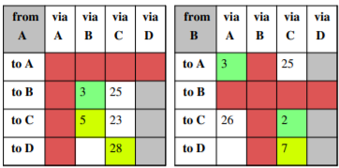
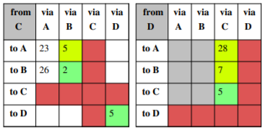
T=1

Slide 10
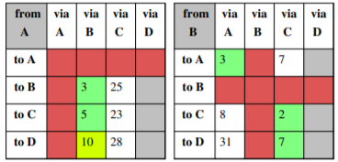
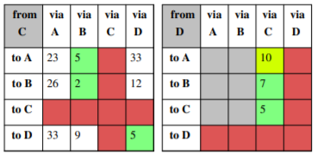
T=2

Slide 11
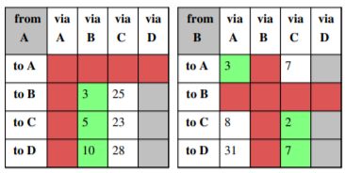
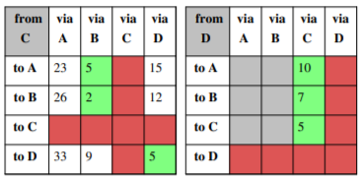
T=3
Notes:
None of the routers have any new shortest-paths to broadcast. Therefore, none of the routers receive any new information that might change their routing tables. So the algorithm comes to a stop.

Slide 12
Advantages of Distance Vector routing –
It is simpler to configure and maintain than link state routing.
Disadvantages of Distance Vector routing –
It is slower to converge than link state.
It is at risk from the count-to-infinity problem.
It creates more traffic than link state since a hop count change must be propagated to all routers and processed on each router. Hop count updates take place on a periodic basis, even if there are no changes in the network topology, so bandwidth-wasting broadcasts still occur.
For larger networks, distance vector routing results in larger routing tables than link state since each router must know about all other routers. This can also lead to congestion on WAN links.

Slide 13
THANK YOU

